Slide 1

Banking Business (Call-Centre) Domain
A retail bank has conducted a series of direct marketing campaigns via phone calls to promote term deposit subscriptions. The bank wants to use machine learning to predict whether a customer will subscribe to a term deposit based on demographic, financial, and campaign-related attributes.

Slide 2

Data Overview
DATASET SIZE 45,211 records and 17 columns
FEATURES age, job, marital, education, default, balance, housing, loan, contact, day, month, duration, campaign, pdays, previous, poutcome
TARGET VARIABLE Term deposit subscription (y)

Slide 3
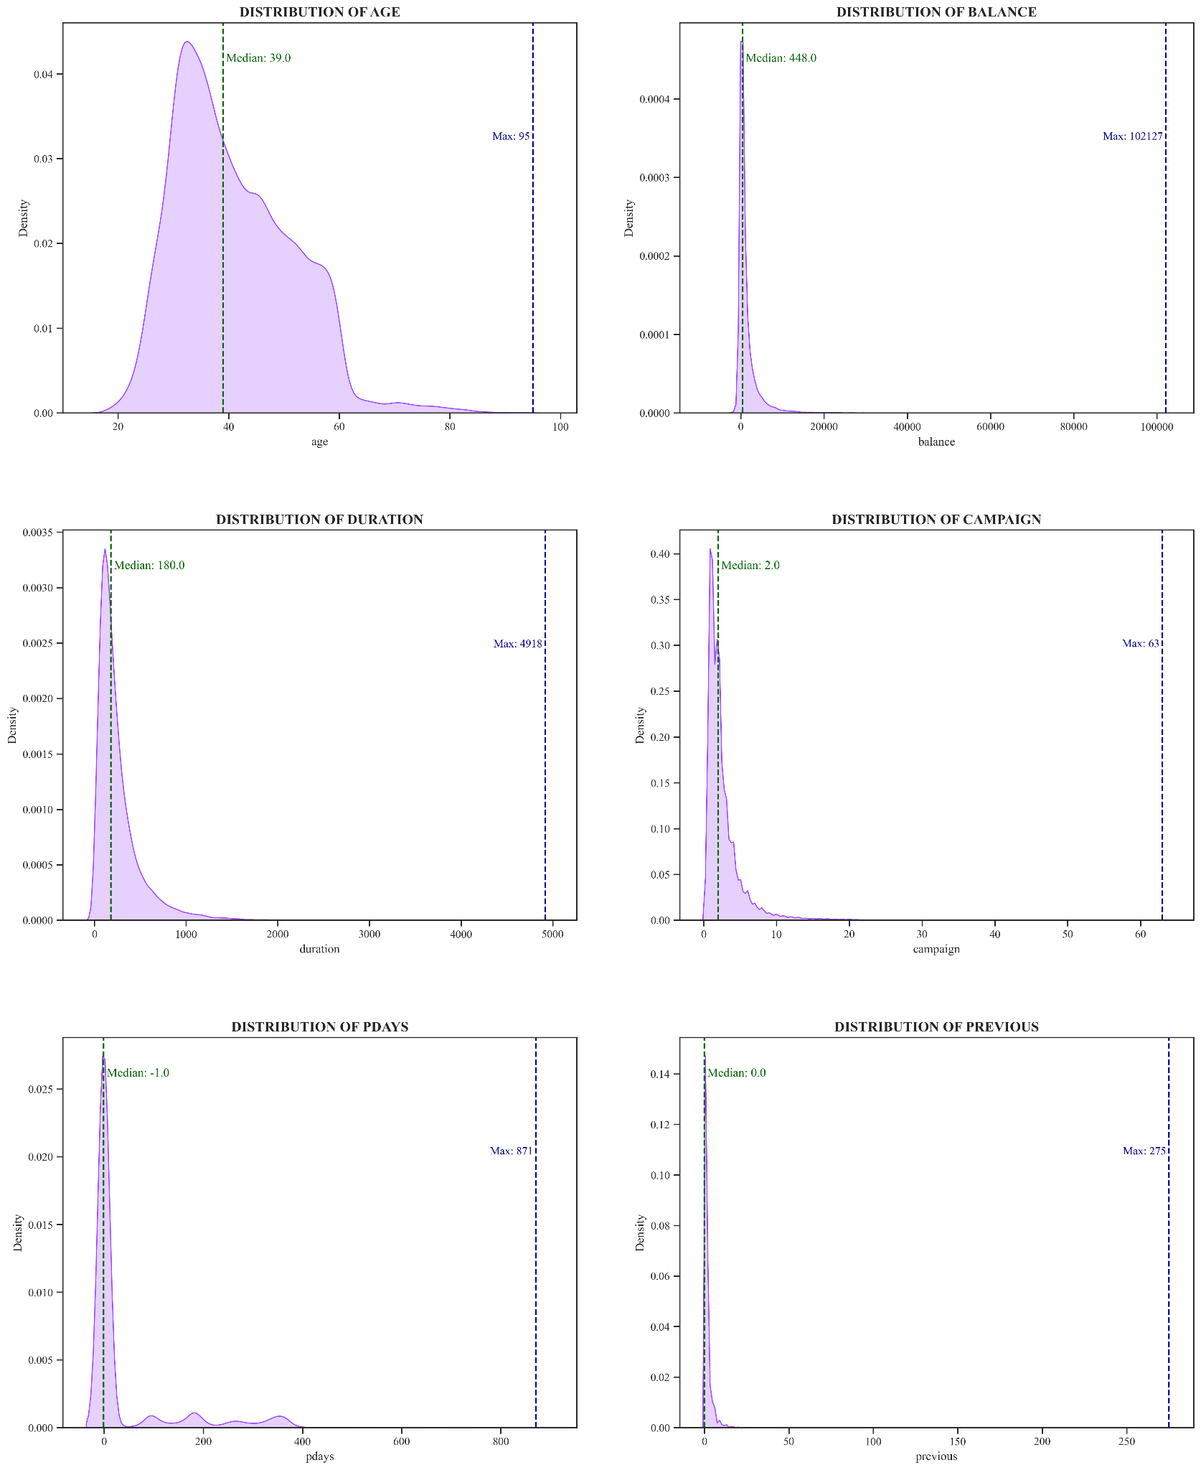
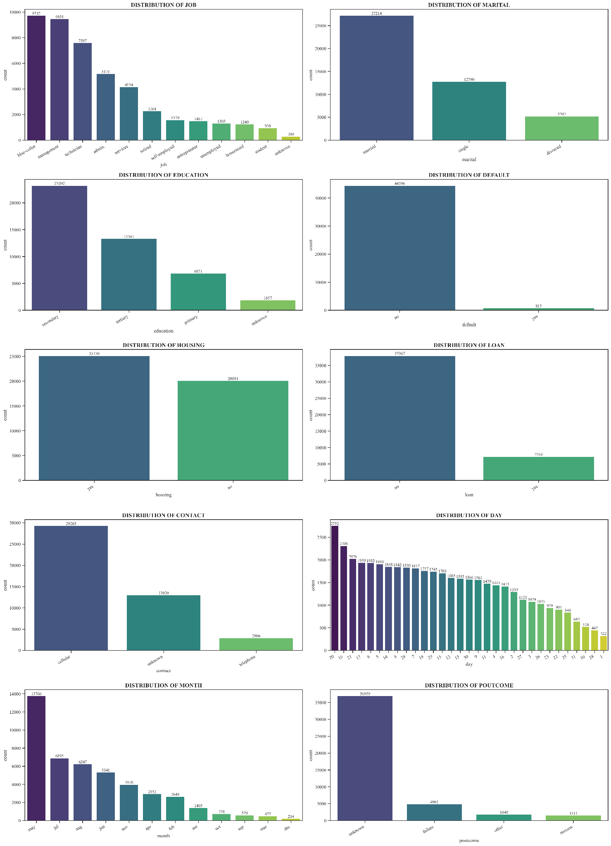
Exploratory Data Analysis - I
Kernel-density plot showed numerical data distribution, helps identify potential outliers
Bar plot showed categorical data distribution in dataset

Slide 4
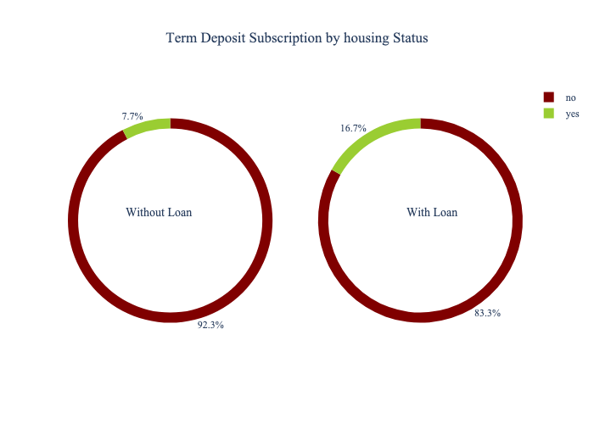
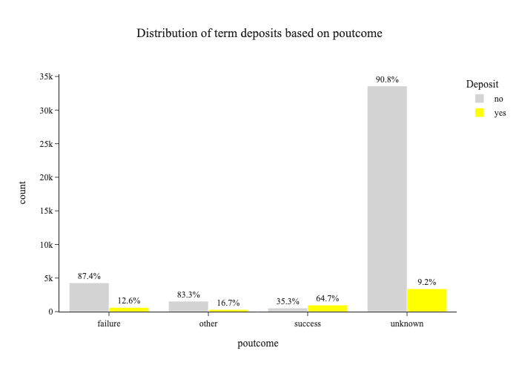
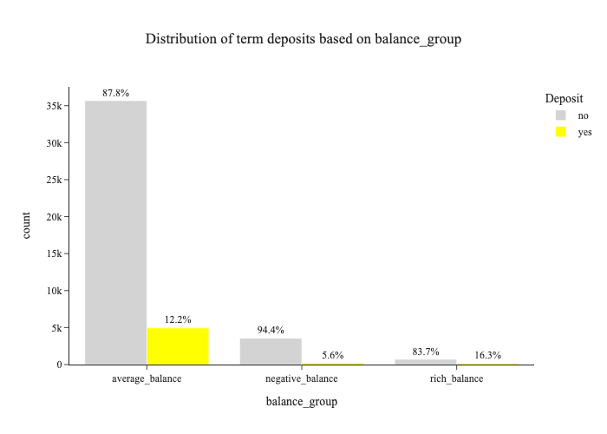
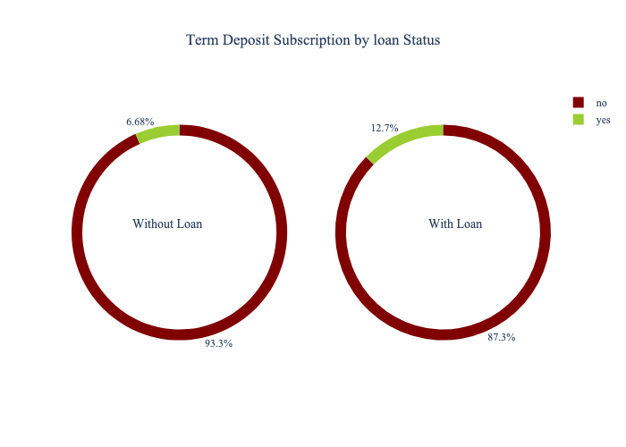
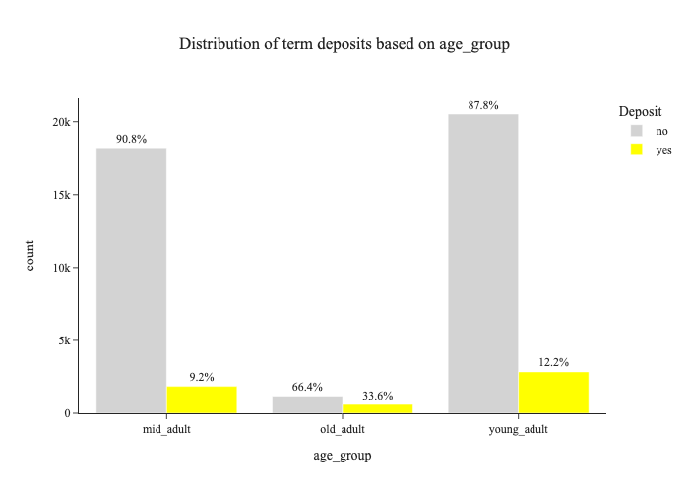
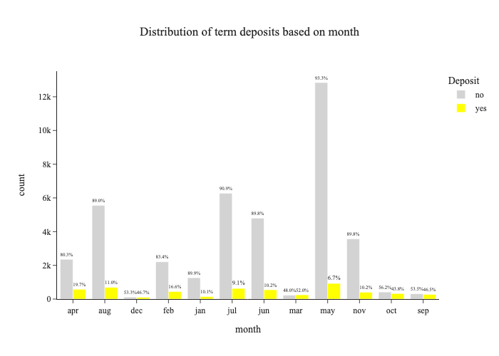
Exploratory Data Analysis - II

Slide 5
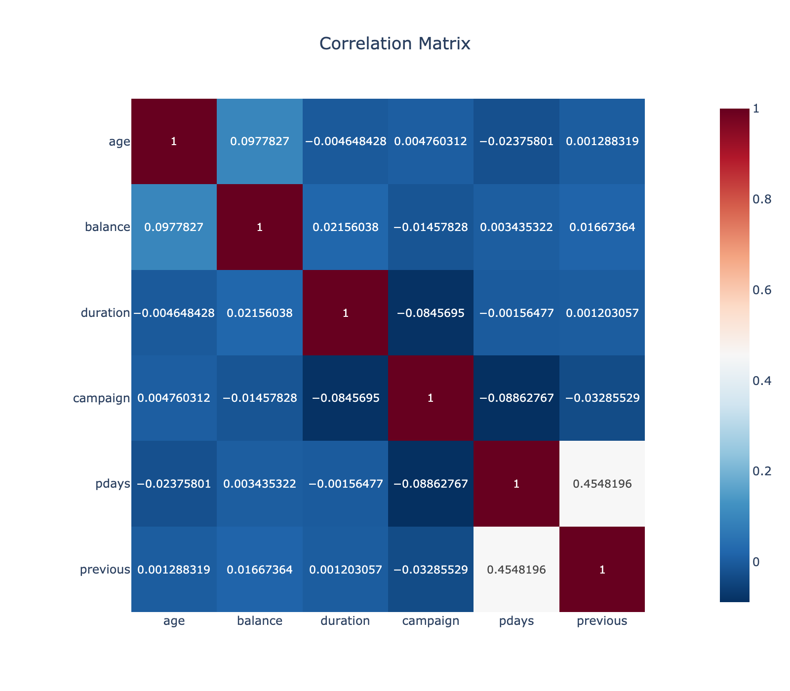
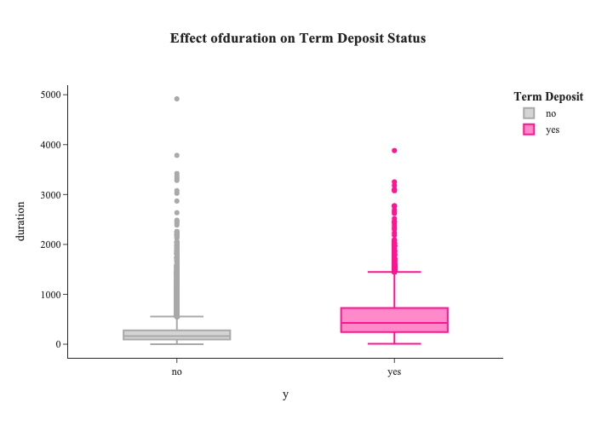
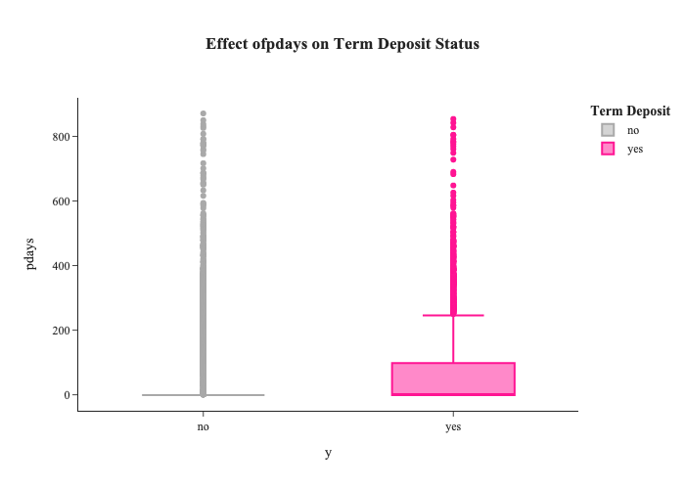
Exploratory Data Analysis - III
There is no multicollinearity between the features.

Slide 6
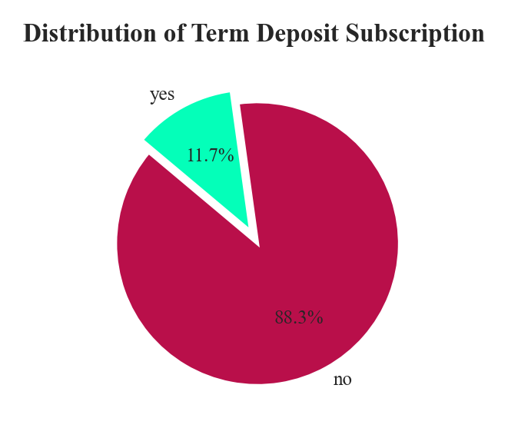
Data Preprocessing
Outlier Treatment
1
Applied winsorization to reduce impact of extreme values
Feature Transformation
2
Transformed pdays(numerical) column to categorical column
Encoding
3
Applied label encoding to binary categories and one hot to nominal categories.
Feature Scaling
4
Applied robust scaling, good for skewed and negative values
Imbalance Treatment
5
Applied SMOTE technique for imbalance treatment

Slide 7
Model Selection
Model Name | Train Accuracy | Test Accuracy | Training Time | Precision | Recall
LogitReg | 0.848177 | 0.878138 | 0.543705 | 0.485733 | 0.70794
DT | 1 | 0.866858 | 0.4236 | 0.4427 | 0.533081
Bagging | 0.995636 | 0.894172 | 2.193822 | 0.550856 | 0.517013
RF | 1 | 0.902245 | 3.75308 | 0.596882 | 0.506616
ETC | 1 | 0.897822 | 3.214554 | 0.576484 | 0.477316
AdaBoost | 0.887219 | 0.887206 | 1.470598 | 0.515152 | 0.610586
Gradient Boost | 0.908296 | 0.894725 | 6.722208 | 0.540707 | 0.665406
XGBoost | 0.957025 | 0.903019 | 0.440174 | 0.597627 | 0.523629
SVC | 0.898843 | 0.878912 | 34.236787 | 0.488545 | 0.745747
GNB | 0.770446 | 0.832025 | 0.018782 | 0.362059 | 0.571834
BNB | 0.756923 | 0.808139 | 0.022688 | 0.324884 | 0.593573
Voting | 0.962328 | 0.901028 | 51.277082 | 0.571933 | 0.612476
XGBoost offers the best trade-off between accuracy, precision, recall, and speed.

Slide 8
Model Training and Evaluation
Data Splitting
Dimensionality Reduction
80% training, 20% testing split for model evaluation.
Used feature importance to reduce
the dimensions.
1
2
3
4
Hyperparameter Tuning
Performance Metrics
Used GridSearchCV to optimize model parameters.
Evaluated model using accuracy, precision, recall, f1-score and PR-curve.

Slide 9
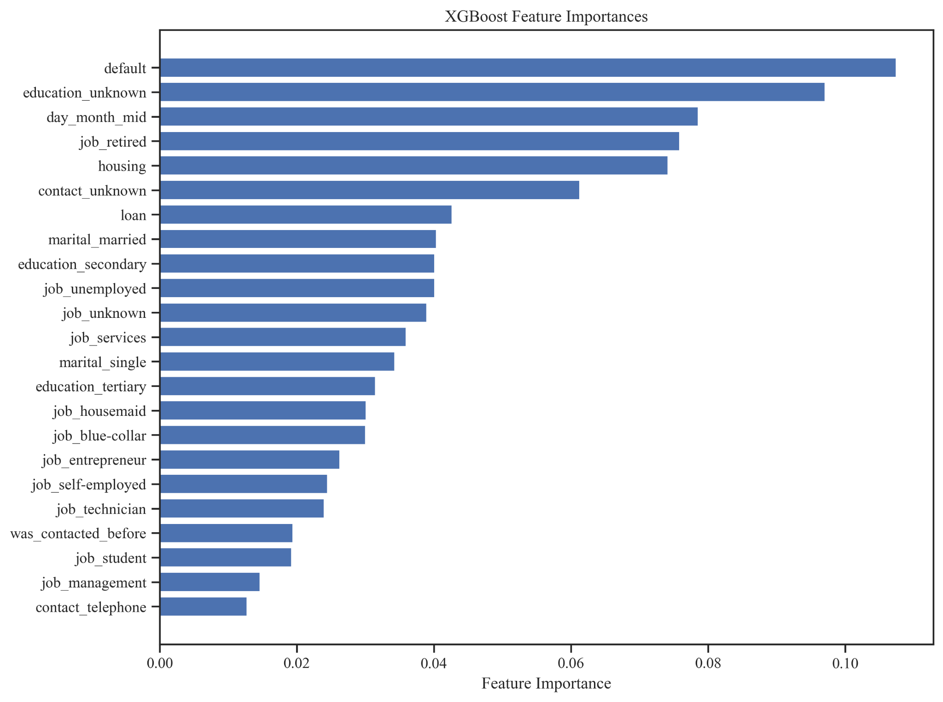
Feature Importance
Selected 23 most important features to reduce dimensions.
There were not declination in performance metrics.

Slide 10
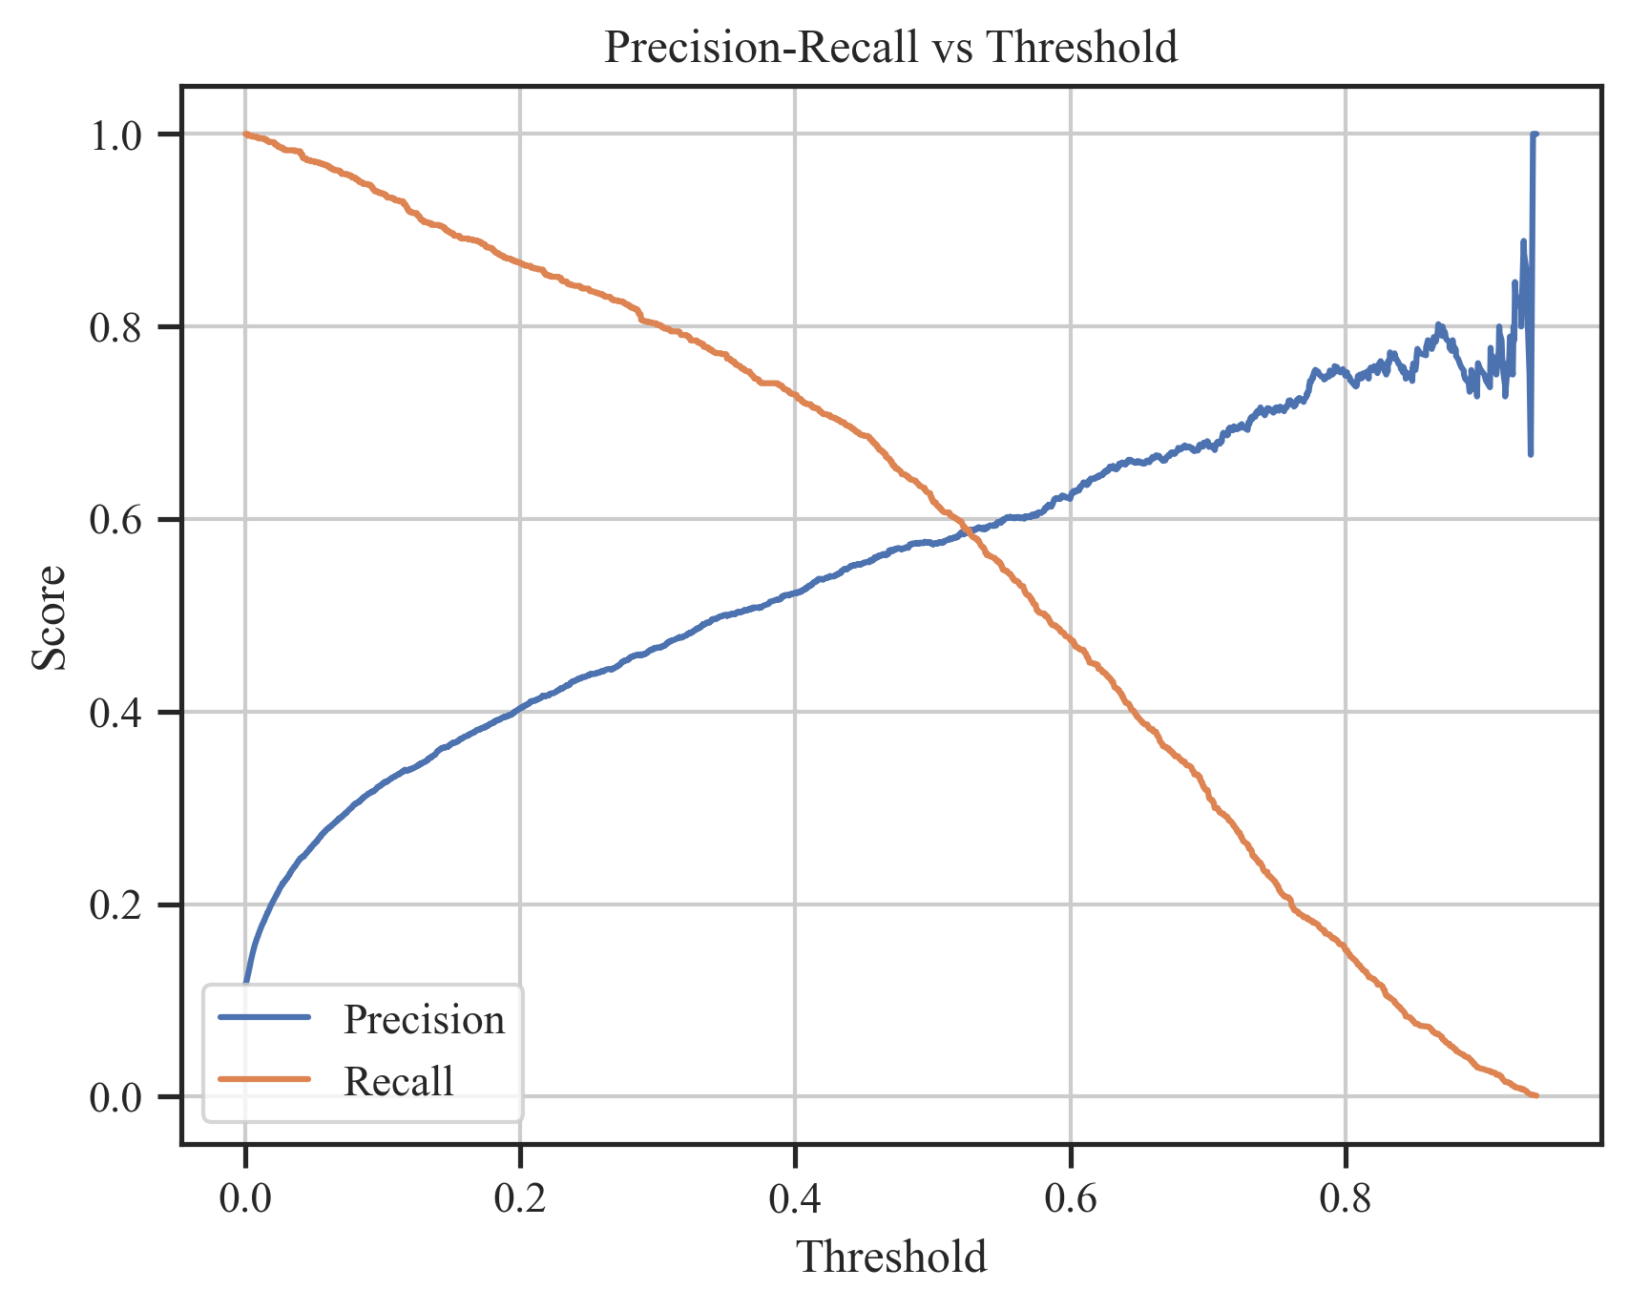
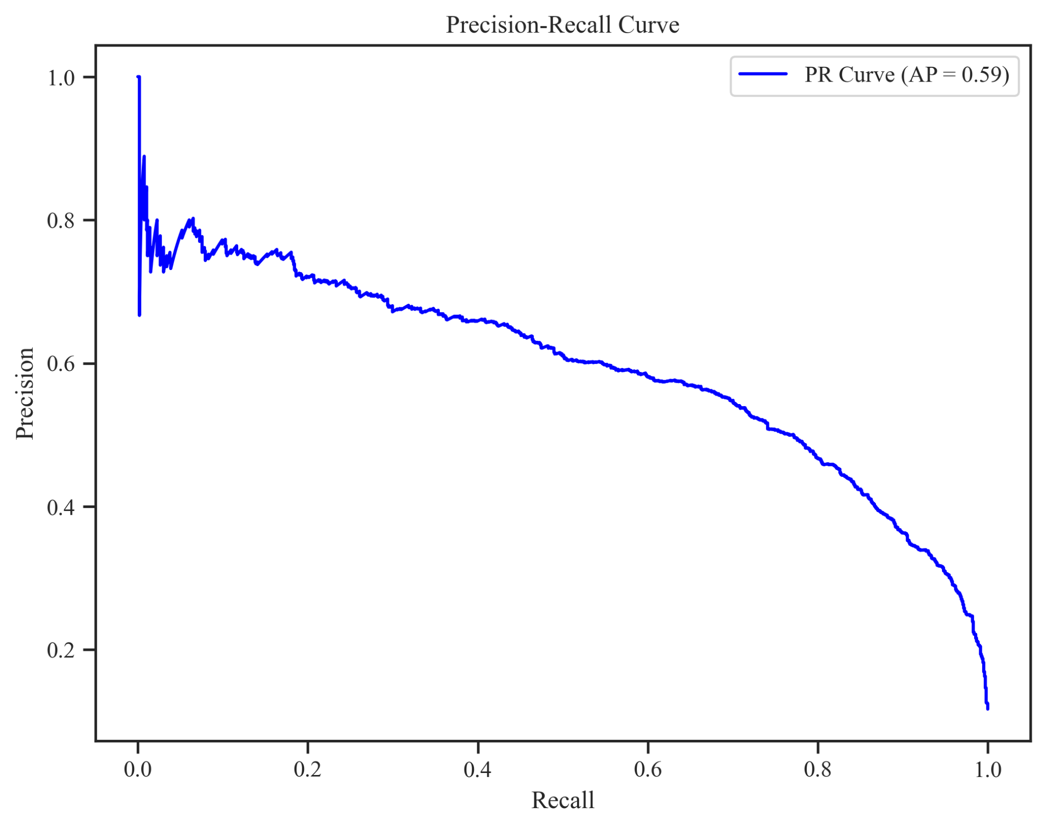
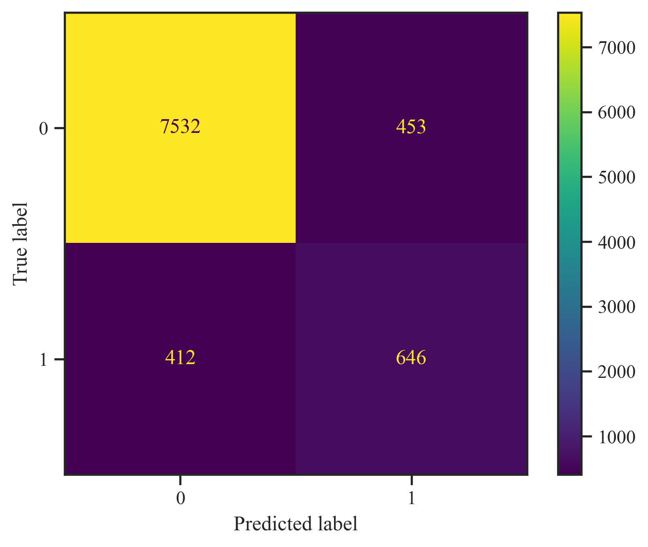
Performance Metrics
Label | Precision | Recall | F1-Score | Support
0 | 0.95 | 0.94 | 0.94 | 7985
1 | 0.57 | 0.62 | 0.6 | 1058
Accuracy |  |  | 0.9 | 9043
Macro Avg | 0.76 | 0.78 | 0.77 | 9043
Weighted Avg | 0.9 | 0.9 | 0.9 | 9043

